Slide 1
EXCEL
V N S Lakshmi Aishwarya Eranki

Slide 2
Question 1: Return Analysis
Total no.of orders:9994
Total no.of orders Returned:296
Percent of Return Orders:2.97%
Insight:
The number of orders which are not returned are greater
RETURN | Return % | Orders | Profit | Sales
NO | 97.03% | 9698 | 263164.7 | 10599341
Yes | 2.97% | 296 | 23232.36 | 888721.3
Grand Total | 100.00% | 9994 | 286397 | 11488062
Inference:
The profit,total sales depends whether the product is returned or not

Slide 3
Question 2: shipping efficiency
Insight:
We can see that the average time /days taken for the shipment of orders is different for different shipping methods. The order of the shipping modes when compared w.r.t the avg days taken is
Same day<First class<Second Class<Standard Class
Inference:
From the graph it is clear that ,
The shipping mode that has the fastest delivery time is the Same Day Shipping Mode and The shipping mode that has the slowest delivery time is the Standard Class Shipping Mode.

Slide 4
Question 3:Customer Segmentation
Insight:
I have segmented the customers based on the profit that is generated on the orders i.e
If the profit is greater than or equal to 100 then high value,
Profit >=0 “medium value”
Profit<0 “less value
Inference:
From the graph, it is evident that the no of medium value customers are greater than that of high value and low value customers
Formula:IFS(U2>=100,"High Value",U2>=0,"Medium Value",U2<0,"Low Value")

Slide 5
Question 4:product performance
Insight:
From the graph we can see that The category with the highest sales is Technology and for bookcases and tables the average profit is in the negative region
Inference:
From the graph,
It is clear that the category with the highest sales and highest average profit is technology and
the category with the lowest sales is office supplies
And the category with the lowest avg profit margin is furniture.

Slide 6
Question 5:regional analysis
Insight:
From the sales by region graph,we can see that the sales amount is highest in the west region and least in the south region .From the profit by region graph, we can see that the profit is greater in west region and least in central
Inference:
Highest sales: West region
Lowest sales: South region
We can see that the profit is greater in the region with the maximum sales amount .

Slide 7
Question 6:discount analysis
Insight:
From the first plot we can clearly see that all sales ,profit and discount are correlated with each other
Inference:
From the sales and discount graph we can see that sales and discount has a negative correlation
And from the discount and profit graph we can see that discount and profit has negative correlation.

Slide 8
Question 7:market expansion
Insight:
Here, the criteria for market expansion is based on the region and the no of orders placed from that region.
Inference:
From the graph we can see what are the states in the different regions where the no of orders are low compared to the other states and we can expand our market by promoting our stores in the areas where the orders are less and also we can increase our market by promoting in the areas where the no of orders are high.
Formula:

Slide 9
Question 8:customer retention
Insight:
These are the top 20 customers with high number if orders
Inference:
We can give promotions and discounts to these customers who are ordering continuously

Slide 10
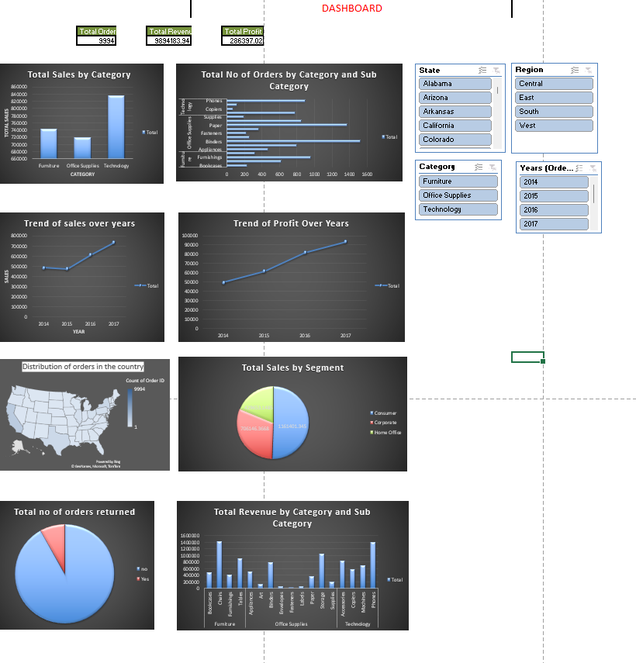
Question 9:DASHBOARD

